Slide 1
The Role of error in assessing English Writing in the Austrian Educational Standards Baseline Test
Florian Pibal, Günther Sigott & Hermann Cesnik
Identifying errors: error analysis
100 writing performances E8
Rated on four dimensions: Task Achievement, Coherence and Cohesion, Grammar, Vocabulary. Fair measures resulting from MFRA
Correlations of error counts with the ratings on the four dimensions

Slide 3
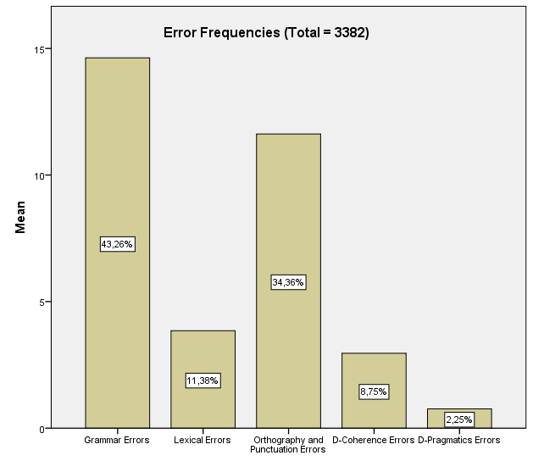
Fig. 3: Error frequencies (linguistic categories)
Tab. 5: Pearson r between Error Ratios and Fair Measures. All correlations sig. at p=0.01 (N=100).
 | TOTAL Fair Measure | GRAMMAR Fair Measure | VOCABULARY Fair Measure | COHERENCE & COHESION Fair Measure | TASK ACHIEVEMENT Fair Measure
Grammar Error Ratio | -.766 | -.766 | -.738 | -.719 | -.618
Lexical Error Ratio | -.405 | -.346 | -.399 | -.393 | -.359
Orth. & Punct. Error Ratio | -.527 | -.523 | -.525 | -.471 | -.423
D-Coherence Error Ratio | -.652 | -.576 | -.614 | -.588 | -.612
D-Pragmatics Error Ratio | -.462 | -.431 | -.398 | -.370 | -.502
Total Error Ratio | -.799 | -.770 | -.773 | -.735 | -.672

Slide 4
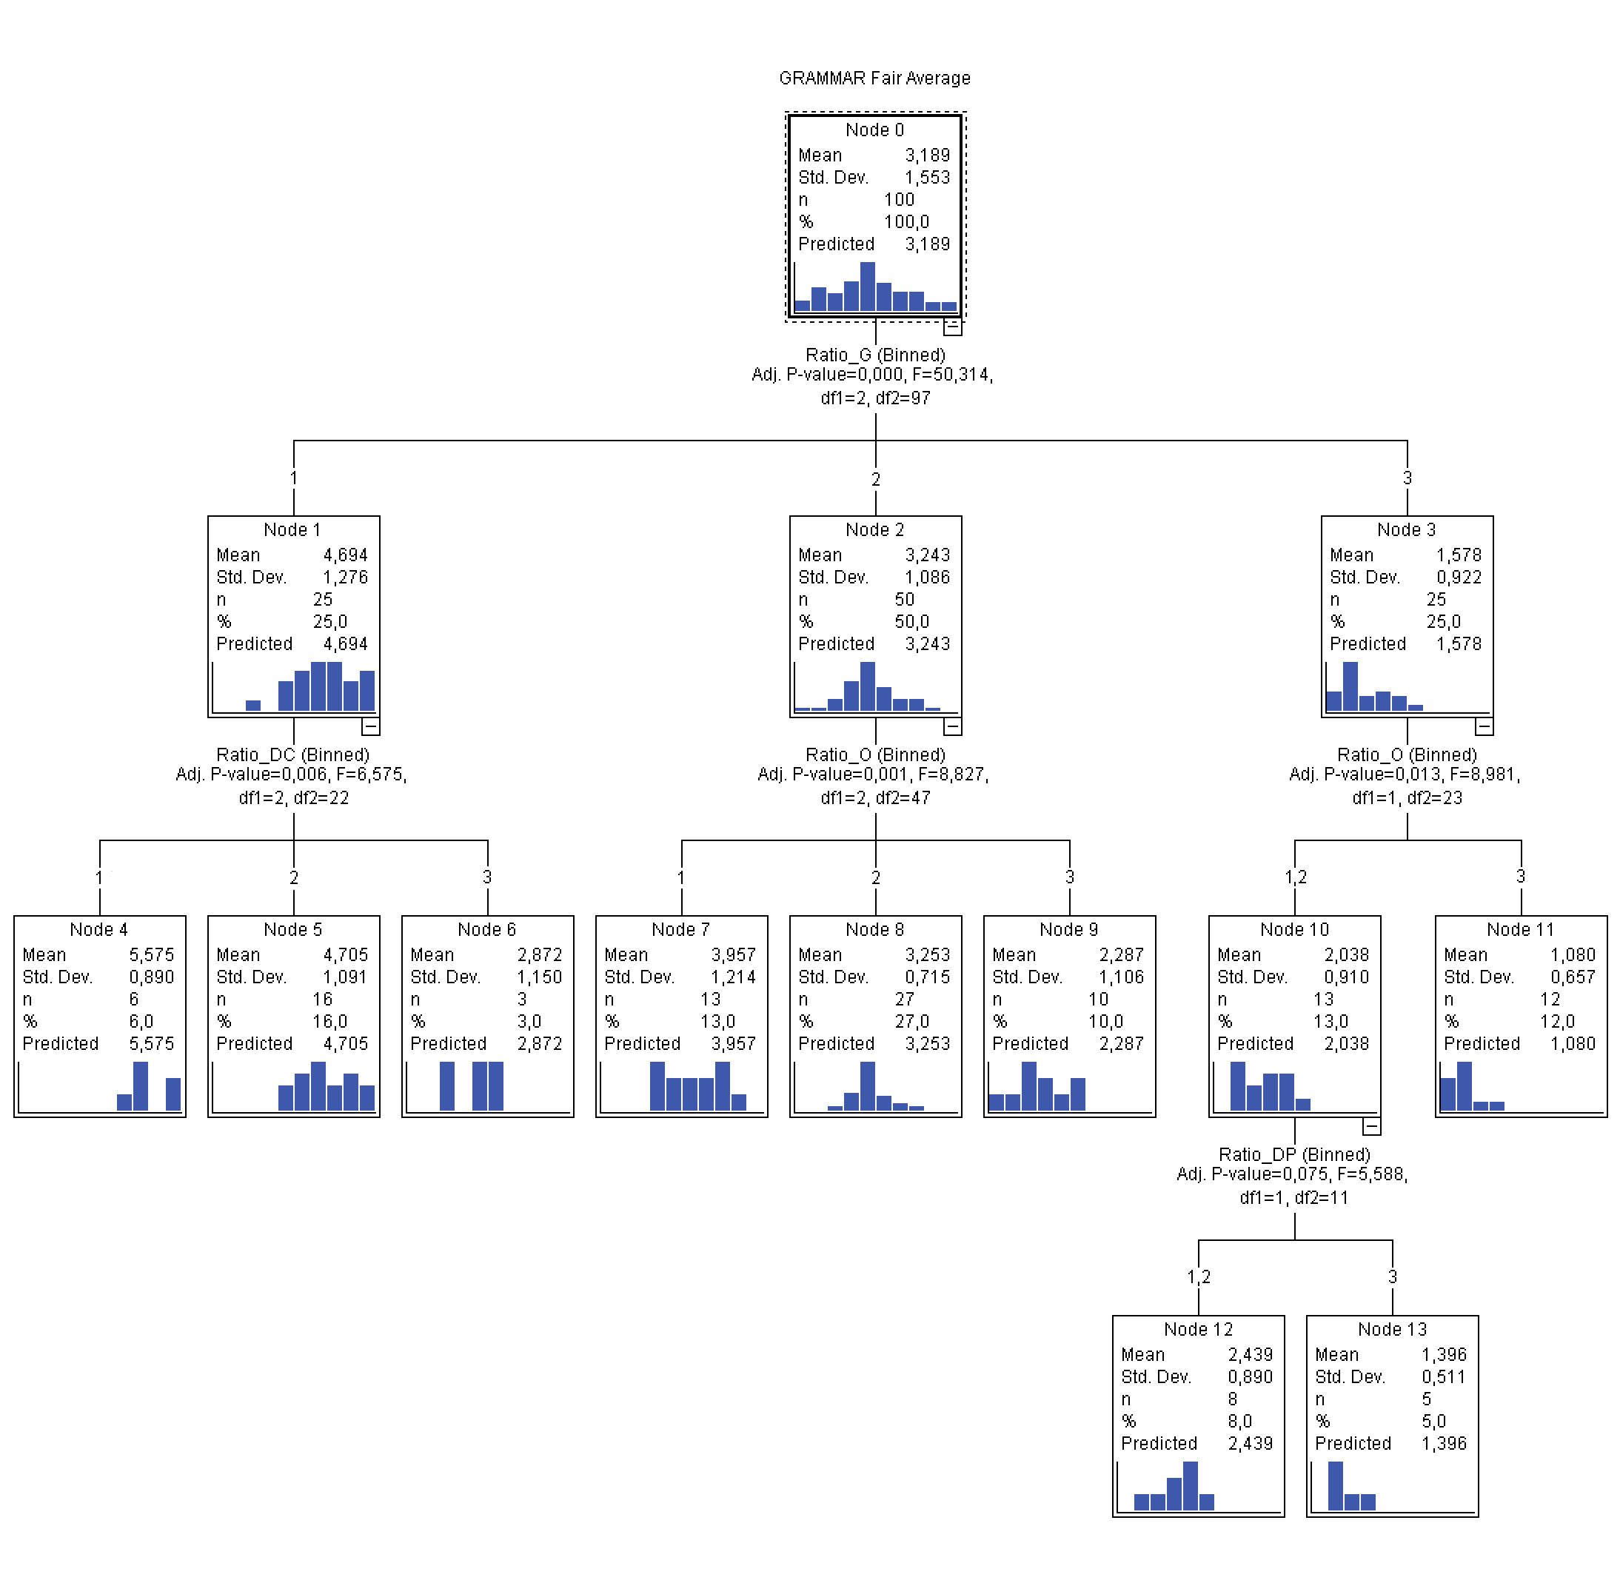

Slide 5
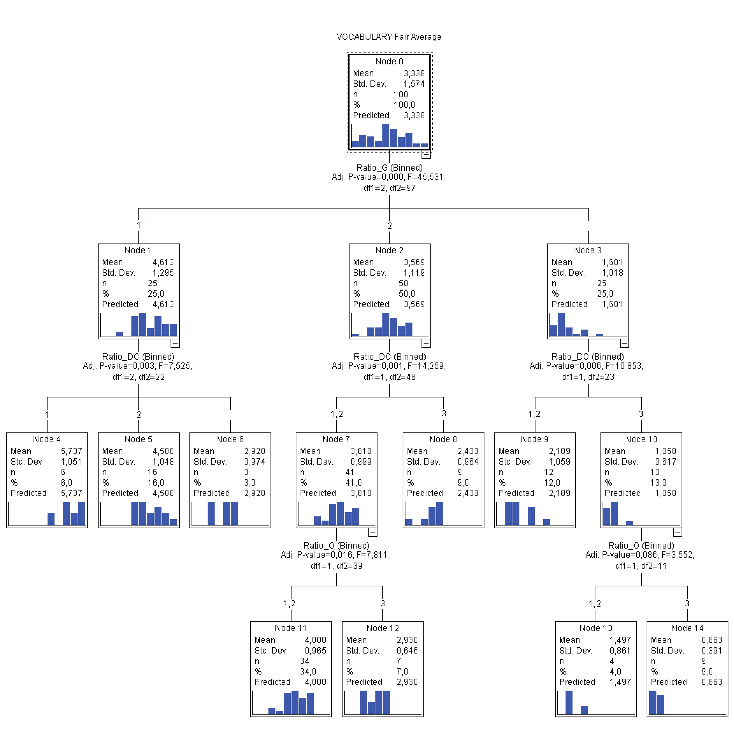

Slide 6
Conclusions
Grammar plays the most important role in the assessment of writing in the E8 Test. Grammar errors are also the most frequent errors. Therefore, an emphasis on grammar in the teaching of writing is justified.
After Grammar Errors, Coherence Errors are the second strongest predictor of the Task Achievement ratings. Task Achievement is primarily seen as a matter of coherence. Consequently, the conceptual distinction between coherence, cohesion and task achievement needs to be sharpened, or if this turns out to be impossible, abandoned.
The VOCABULARY rating dimension needs to be examined carefully. It does not seem to be sensitive to lexical errors per se but rather to issues to do with grammar and coherence. Impossible to distinguish between grammar and vocabulary in a principled way (cf. Alderson and Kremmel 2013)? Raters may be particularly sensitive to positive features in the VOCABULARY rating.
Orthography & Punctuation Errors influence the ratings on all four dimensions, but always in a subsidiary role.
Qualitative research into raters’ decision-making behaviour is needed to supplement the results.

